Slide 1

EVENT MANAGEMENT SYSTEM
By Dhanushya Thangavel

Slide 2

PROJECT OVERVIEW
A console-based application developed in Java
Focuses on managing company events
Employees can register for events
Managers can create and manage events

Slide 3
MODULES
1. Manager:
Create Events
Edit Events
View All Events
Delete Event
View Employee Registrations
2. Employee:
Register for Events
Edit their Registration

Slide 4
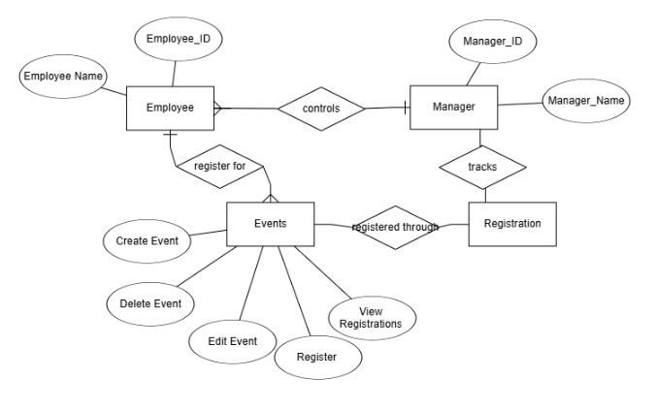
ER DIAGRAM

Slide 5
SAMPLE INPUT AND OUTPUT
--- Manager Menu ---
1. Create Event
2. Edit Event
3. View All Events
4. Delete Event
5. View All Registrations
6. Exit
Enter your choice: 1
Enter Event ID: 30
Enter Event Name: FundTalk
Enter Event Description: About the fund transfer for hardware team
Event created.
--- Manager Menu ---
1. Create Event
2. Edit Event
3. View All Events
4. Delete Event
5. View All Registrations
6. Exit
Enter your choice: 3
4,Project Review - Phase 1,Java project review for all employees , please register for the same
14,Event selection,Event selection for the people who have resgitered for the events
3,Technical meeting ,Project hardware selection
30,FundTalk,About the fund transfer for hardware team
--- Manager Menu ---
1. Create Event
2. Edit Event
3. View All Events
4. Delete Event
5. View All Registrations
6. Exit
Enter your choice: 5
--- Registered Employee IDs ---
Employee ID: 52
Employee ID: 7
Employee ID: 82

Slide 6
CONCLUSION
Thus created a Event management system , where employees can easily register for events and manager can track the Employee’s registrations

Slide 7
THANK YOU

